Slide 2
Notes:
Workforce Services has many different divisions and provide many different services.

Slide 4
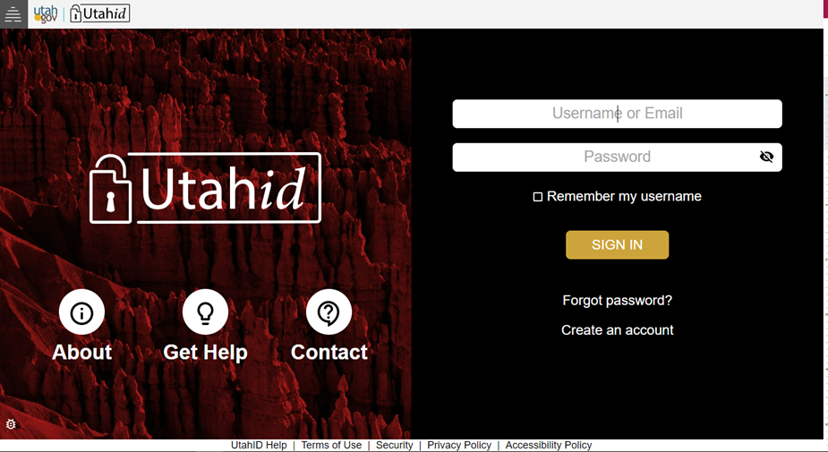
Notes:
You will need to create a UtahID if you do not already have one. You must have a valid email address to do so. Once created, you will use this each time you log into jobs.utah.gov in the future.

Slide 5
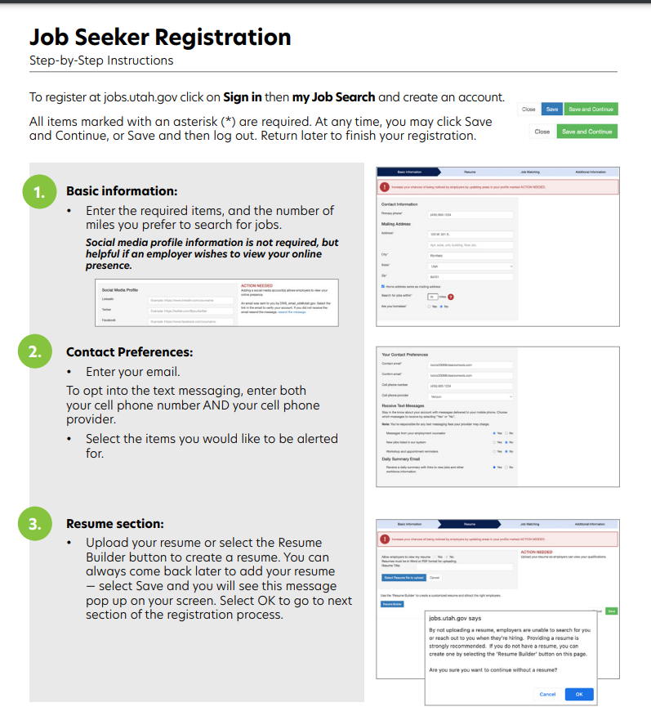
Notes:
My job search will walk you through a registration process where you will enter in basic information, contact preferences and a current resume.

Slide 6
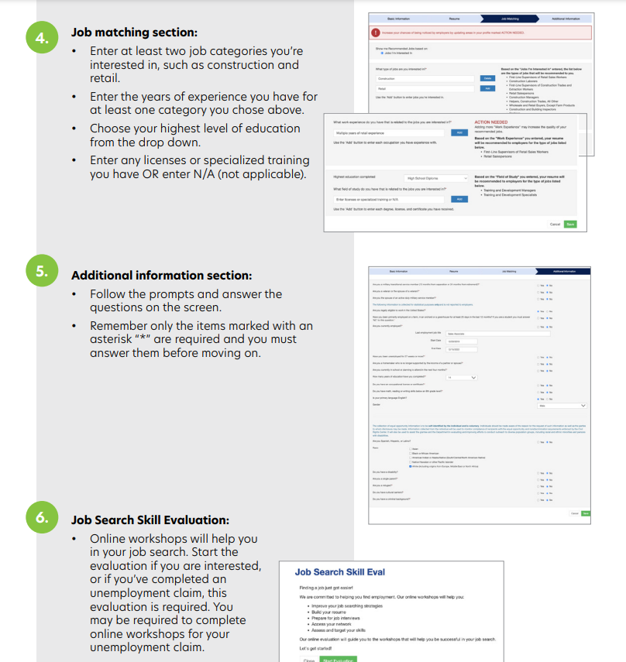
Notes:
My job search will walk you through a registration process where you will enter in basic information, contact preferences and a current resume.

Slide 7
Pre-Recorded Online Workshops
Budgeting Basics
Interviewing
Job Searching Strategies
Networking
Professionalism in the Workplace
Resume & Application
In Person and Live Virtual Workshops
Find a Job you Love
Interviewing Skills
LinkedIn
Resume Writing
Healthy Relationships
Notes:
Job seekers have can access many tools and workshops to assist them in their job search and more.

Slide 8
Notes:
Finding a job you love starts with a successful job search, and a successful job search starts before you apply for jobs, submit resumes or set up interviews!
Jobs.utah.gov has an array of services, tools and resources on the Job Search Tools page to assist you. That’s where you can find the SmartStart Guide which is a step-by-step job search guide, from A - Z! (Show how to access the Job Search Tools page from jobs.utah.gov home page and click on a a resource and click on the SmartStart Guide.)
We also have team members who can help if you want to visit a local office for assistance.
And, be sure to stay informed on the most current strategies for job searching during COVID-19.
Let’s look at how to set up a successful job search, starting with Professional Image.
Resources: Job Search Strategies and Professionalism in the Workplace online workshops: https://jobs.utah.gov/jobseeker/workshops/ and referring to the SmartStart Guide Searching for Jobs Section: https://jobs.utah.gov/jobseeker/smartstart.pdf

Slide 9
Held every quarter
Hire employees online
No cost to employers
The next virtual job fair is Thursday March 7, 10 a.m. to 1 p.m.
Contact your workforce development specialist for a booth

Slide 10
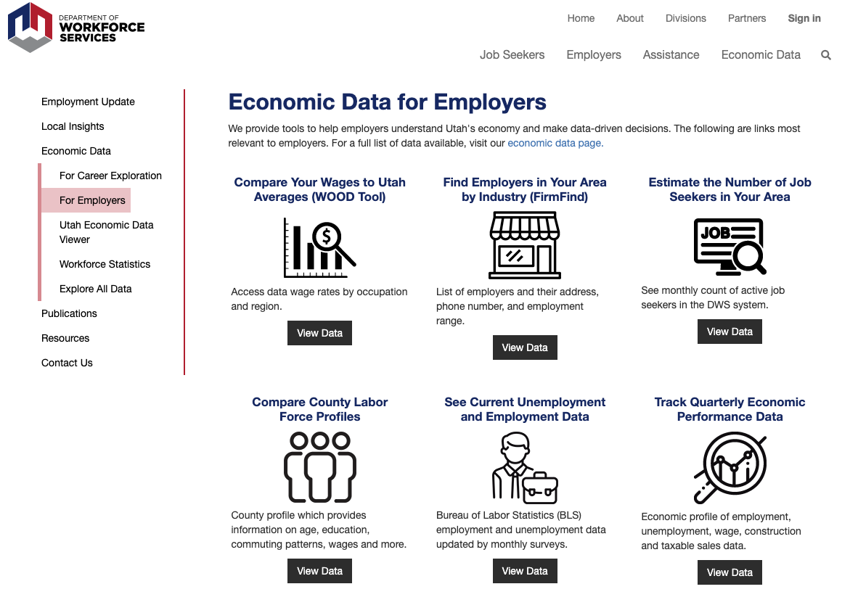

Slide 11
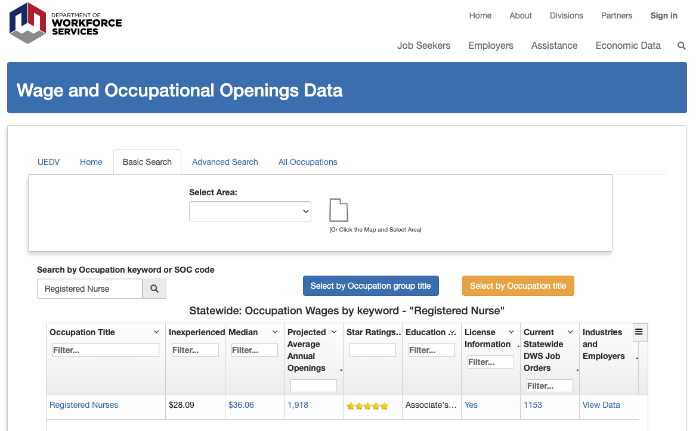

Slide 12
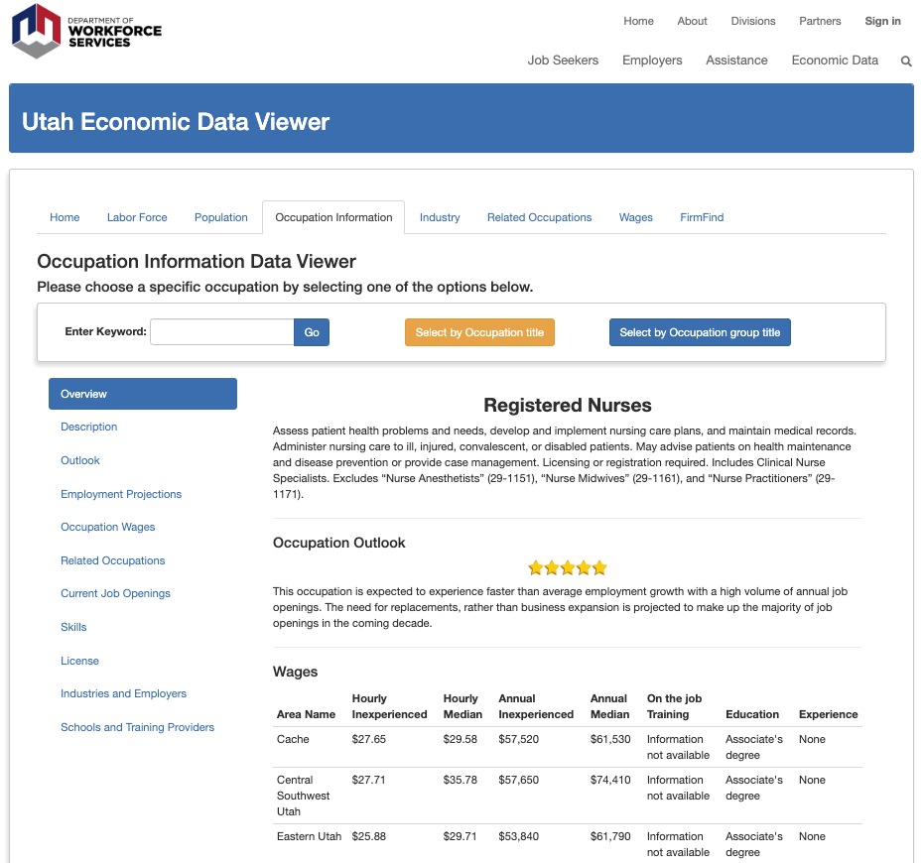

Slide 14
jobs.utah.gov/career
Notes:
We can provide career counseling and funding for education costs to move individuals forward in a career that is right for them.
We have many different services and resources available that can be provided to individuals depending on their career plan and needs.

Slide 16
Notes:
If you have limited work experience, want to explore an occupation or need help to get on the job training in a new occupation we can provide assistance placing an individual on a work experience opportunity including job shadowing, youth internships, on the job training and apprenticeships. Customers participating in internships, on the job training or apprenticeships will earn wages and Workforce Services will reimburse the employer for some of the wages earned to offset the cost of training an employee with limited experience.

Slide 17
Benefits to Employers:
Provides up to 50% reimbursement to employer for training the participants
Reimbursement to help offset expenses incurred during new employee training for qualified employees
Opportunity to train employees to the specific methods of your company
Workforce Services will refer potential employees to you for interview selection

Slide 18
Employer reimbursement of 100% up to 13 weeks for eligible employees
Provides hands on work experience for youth up to age 24
Allows temporary help to employers
Up to $450 supervisor payment for training the intern

